Slide 1
Identifying homonyms and affiliation for bibliographic data using web scraping
Mentor: Dr. Suman Kundu
Akshay Malav (B16CS003)
Chinmay Garg (B16CS041)

Slide 2
Project objectives
To find the affiliation history of a researcher.
To solve the homonym problem.
Finding mis-entries in DBLP identified homonyms.
To find the gender associated with a researcher.

Slide 3
Affiliation history
Finding the year-wise affiliation of a researcher.
Possible approaches:
(i) Downloading the paper and then extracting the affiliation information from the paper.
(ii) Use of web scraping to get the affiliation.

Slide 4
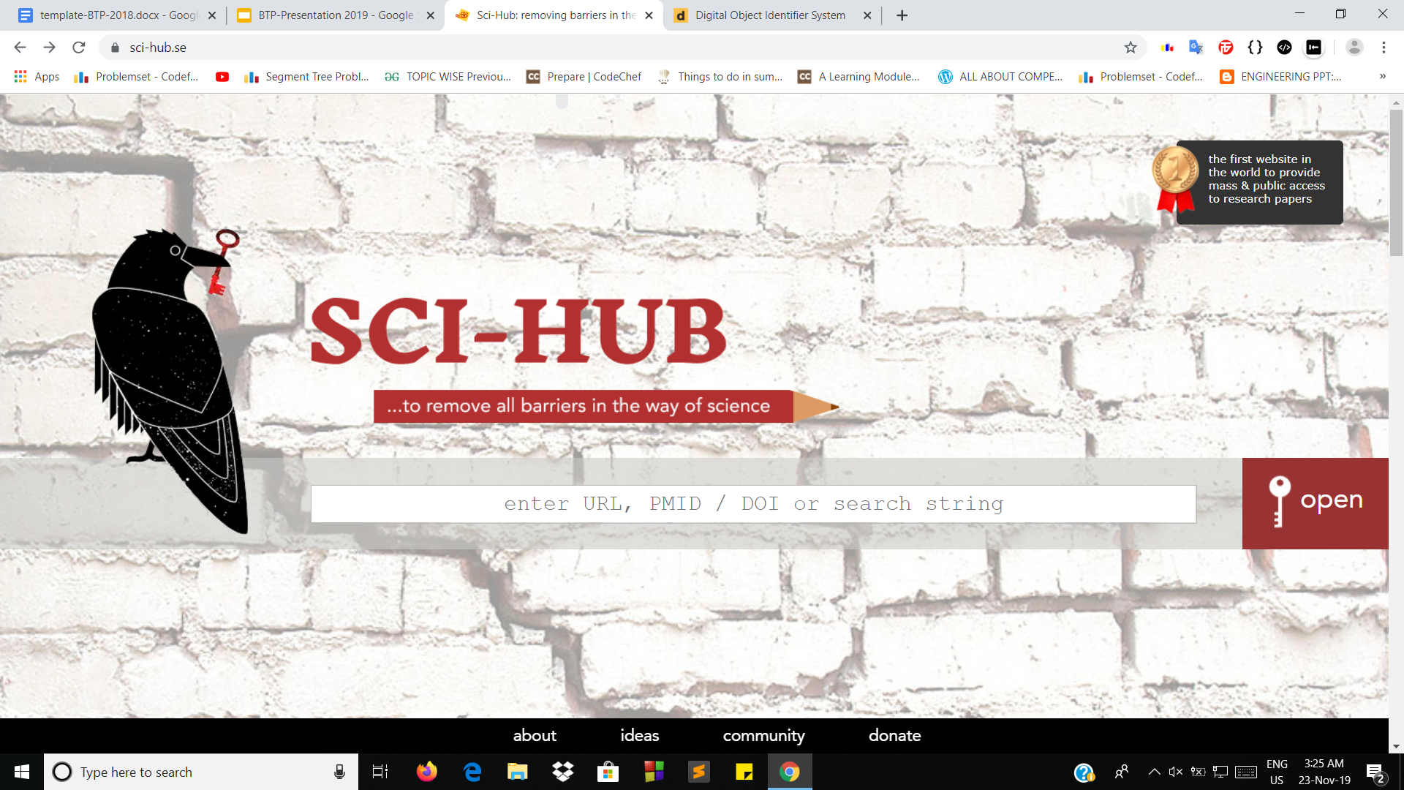
First method
Step-1: Downloading the paper
Google Scholar
Sci-hub

Slide 5
First method (contd.)
Step-2: Extracting the affiliation
E - Mail
Keywords
CERMINE

Slide 6
Second method
Used web-scraping to get the affiliation
Steps involve:
(i) Getting the DOI link from the dblp database
(ii) Scraping the affiliation from the DOI link
(iii)Finally mapping the year to the affiliation

Slide 7
Second method (contd.)
Digital Libraries Scraped:
IEEE
ACM
ScienceDirect
Springer

Slide 8
Homonym problem
Let’s say someone searches his/her name on dblp and finds out that there are 10 papers associated with him/her.
But the person knows that he/she has published only 2 papers. Then those extra 8 papers are wrongly associated with the person.
That means there is another person with the same name to whom these 8 papers belong. This is homonym problem

Slide 9
Algorithm

Slide 10
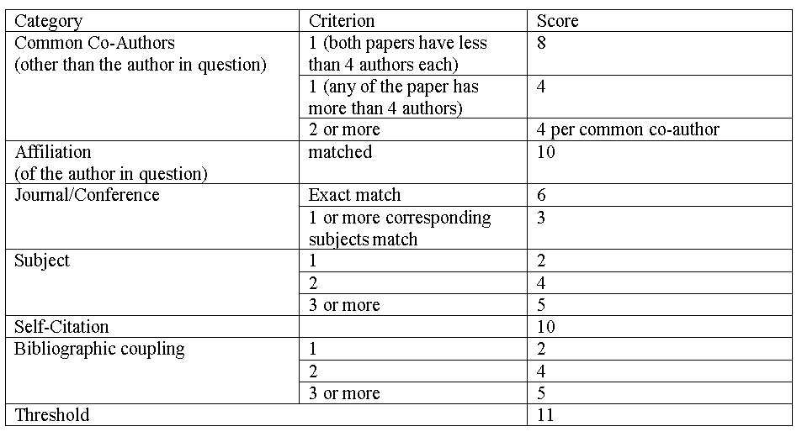

Slide 11
Damerau - Levenshtein Distance
Consider the following three cases:
The author's name that is given on the DBLP might not be in the exact same manner as on the website from which we are scraping the author - affiliation mapping.
Affiliation of the author in two different papers might be represented in different manner, e. g., IIT Jodhpur, Indian Institute of Technology Jodhpur, etc.
Author may use different ways of writing citations/references in different papers.

Slide 12
Extracting subjects
We can guess the subject of the paper from the conference it is published in.
Few lists:
University of Alberta
John Hopkins University
Wikipedia
Scimagojr
DBLP has 11940 conferences and 4612 journals.

Slide 13
Extracting subjects
2. Distant learning
3. Keywords
4. Microsoft academic

Slide 14
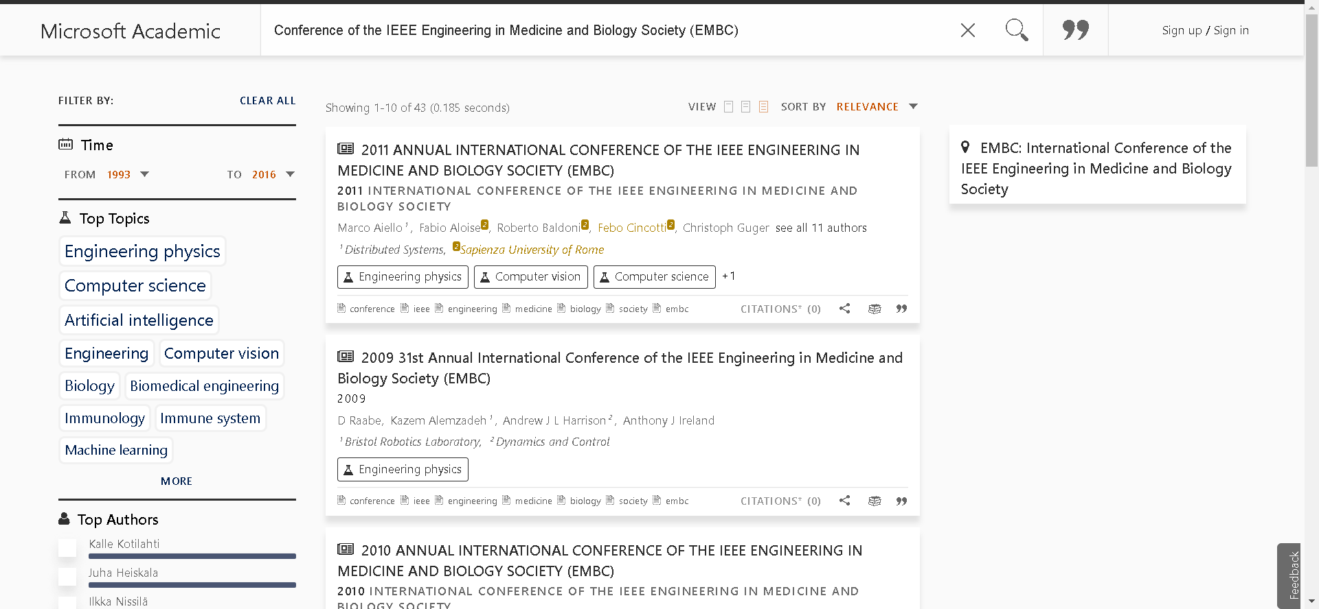

Slide 15
Observations

Slide 16
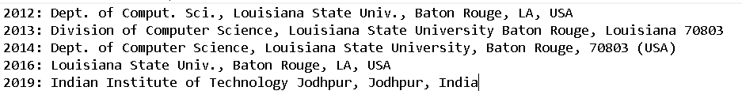
Affiliation history of Subhajit Sidhanta

Slide 17
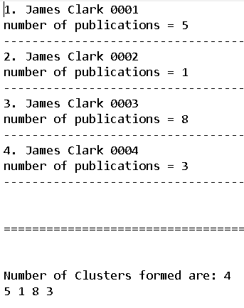
Verification of algorithm

Slide 18
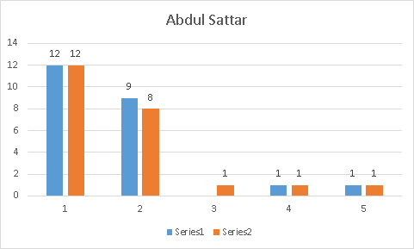
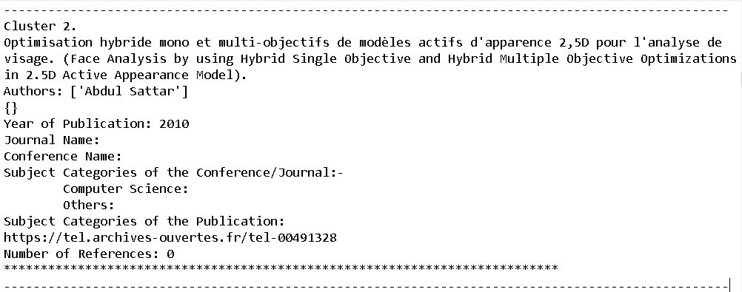

Slide 19
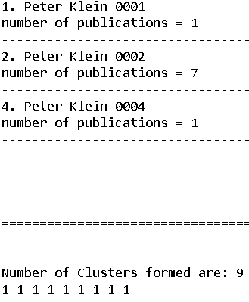
With affiliations of only 1 out of 9 papers

Slide 20
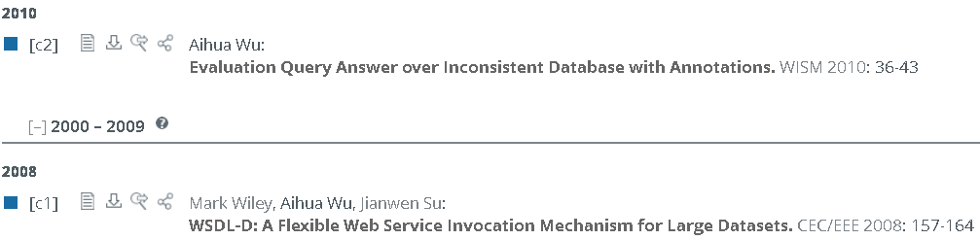
Aihua Wu 0002
Mis-entries in dblp identified homonyms

Slide 21
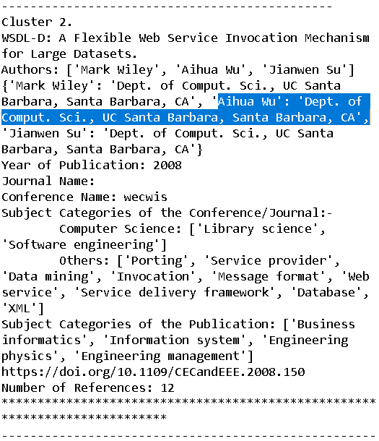
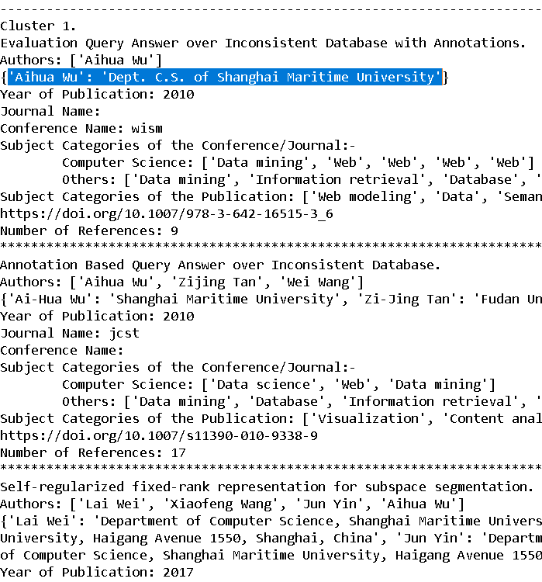

Slide 22
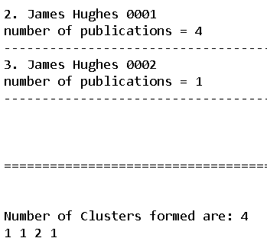
Homonym?
James Hughes 0002
James Hughes 0001
Jim Hughes

Slide 23
Thank you

